Slide 1
Specification (II) and architecture (I)
SOFTWARE ENGINEERING · LECTURE 3 · W4 · 19–23 OCT
Does it hold? And what must the architecture support?
Rareș Cristea · FMI-UB · 2026–27
1 / 32
Notes:
Lecture 3, school week 4. First half closes the specification block that started last week; second half opens architecture. Workshop 1 is next week.

Slide 2
From requirements to architecture
WHERE WE ARE
W3 · done
W3 · done
W4 · first half
W4 · second half
What do we have?
What do we want?
Does it hold?
What must it support?
Resources, constraints, risks.
Elicitation, and mining the MDS repository.
Written so it can be checked, validated, negotiated, kept under change.
The few architecture characteristics that shape the structure.
Next week is workshop 1 (W5, 26–30 Oct): you bring the direction of your project, and we confirm it there.
Software Engineering 2026–27 · Lecture 3
2 / 32
Notes:
The only overview slide of the lecture. Last week: what we have and what we want. Today two questions: whether the requirements we found hold up, and what they mean for the architecture. No separate agenda or recap slide: the two part dividers mark the transitions.

Slide 3
Does it hold?
PART 1
Requirements that can be checked, agreed on, and kept true as they change
Software Engineering 2026–27 · Lecture 3
3 / 32
Notes:
Part 1, about 50 minutes. Sommerville chapter 4 (sections 4.1, 4.4, 4.5, 4.6), plus the negotiation section of Richards & Ford chapter 23.

Slide 4
One requirement, two readings
THE COST OF AMBIGUITY
Mentcare: “A user shall be able to search the appointments lists for all clinics.”
What the medical staff meant
What was easier to build
Same with an agent
Type a patient's name, search all appointments at all clinics. Confused patients sometimes turn up at the wrong clinic.
Pick a clinic first, then search the patients of that clinic. More input, slower, and not what was needed.
A coding agent given this sentence also picks a reading. Unless told to ask, it won't, and its choice looks plausible in review.
“It is natural for a system developer to interpret an ambiguous requirement in a way that simplifies its implementation.”
Source: Sommerville, Software Engineering, 10th ed., §4.1.1, p. 106–107. Third card: course content.
4 / 32
Notes:
Sommerville's own example. The requirement looks clear until two people read it. The rationale (confused patients going to the wrong clinic) is exactly what was missing from the sentence; we come back to rationale in a few slides. The third card is the course's: an agent resolves ambiguity silently, in the direction of whatever is simplest to generate. That is why the rest of this part is about writing requirements so they leave less room.

Slide 5
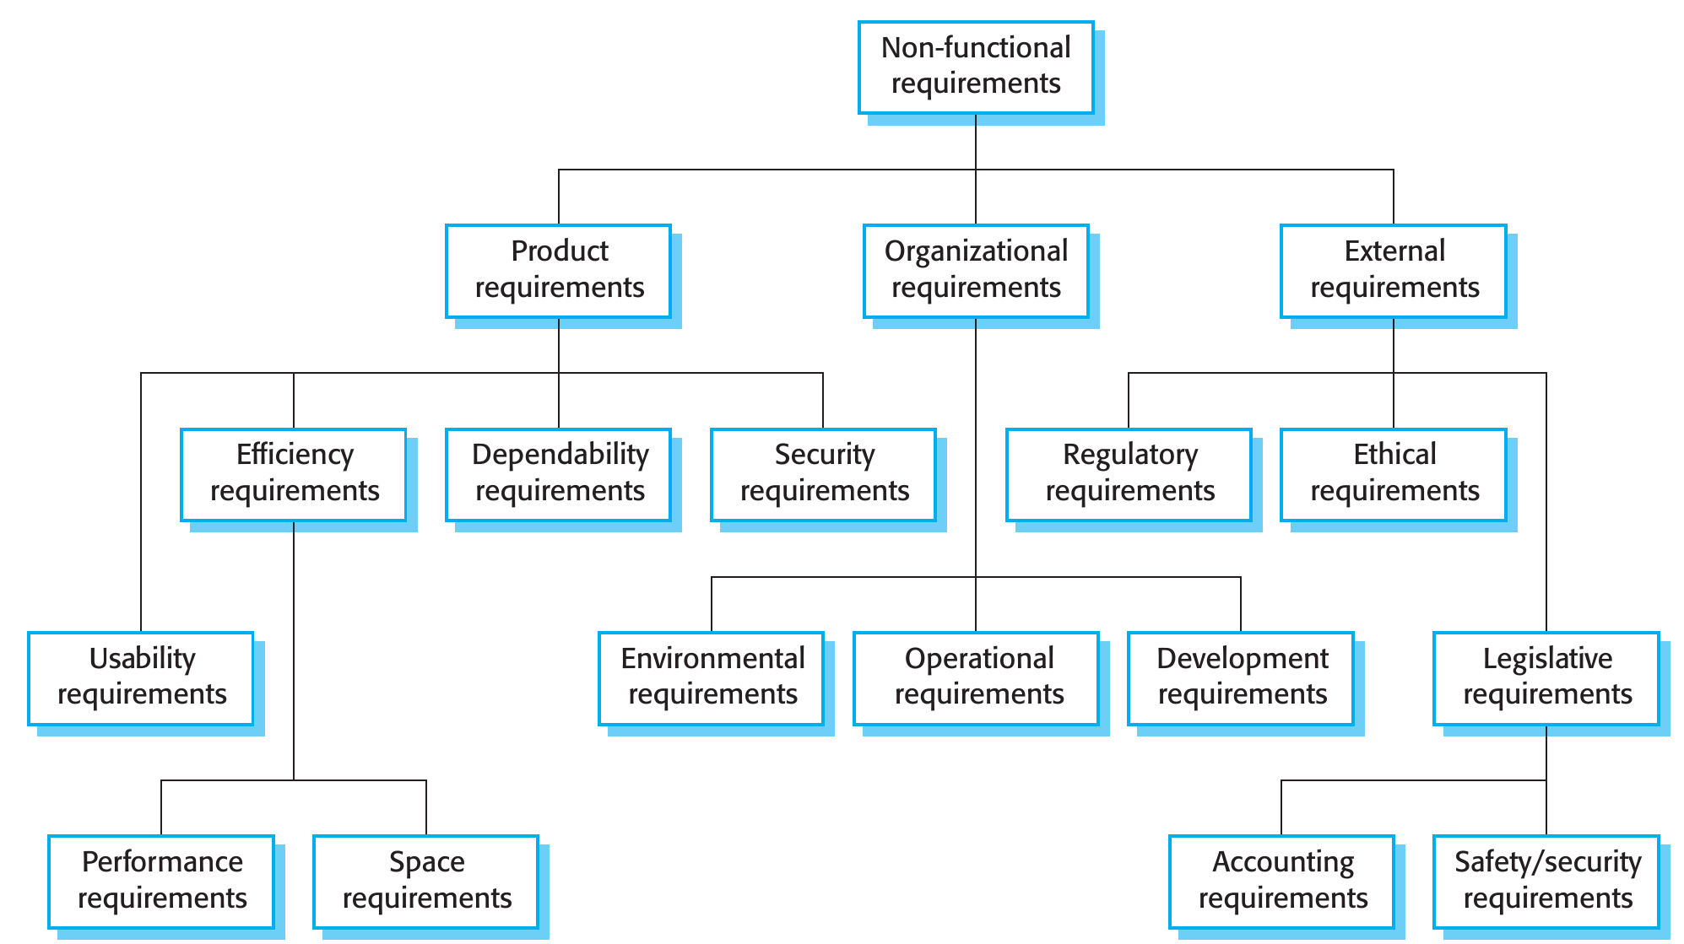
Product, organizational, external
NON-FUNCTIONAL · WHERE THEY COME FROM
Product
Constrain runtime behaviour. Mentcare: open Mon–Fri 08:30–17:30, under 5 s downtime a day.
Organizational
From the organizations' policies. Mentcare: users log in with their ID card.
External
From laws, regulators, ethics. Mentcare: follows the national patient privacy standard.
“Patient data shall not be sent to an external AI service.” Organizational if it is the clinic's policy, external if it follows from GDPR.
Source: Sommerville, Software Engineering, 10th ed., §4.1.2, p. 108–109, Figures 4.3 and 4.4.
5 / 32
Notes:
Figure 4.3 is the classification; the right-hand side gives Sommerville's Mentcare example for each branch (Figure 4.4). The new part compared to MDS is the three branches, not the list of qualities. The callout is a requirement of the kind teams now meet in practice: a rule about which data may go into an AI service. It is non-functional (it constrains how the system works, not what it does), and its source decides the type: the clinic's own policy makes it organizational, data-protection law makes it external. The type tells you who can change it: the client can relax its own policy, nobody can relax GDPR.

Slide 6
A goal is not a requirement
NON-FUNCTIONAL · FROM GOALS TO REQUIREMENTS
Usability goal, as a manager would say it
Why goals hurt
“The system should be easy to use by medical staff and should be organized in such a way that user errors are minimized.”
Open to interpretation, then to dispute after delivery.
The same, as a verifiable usability requirement
From MDS: property → measure
“Medical staff shall be able to use all the system functions after two hours of training. After this training, the average number of errors made by experienced users shall not exceed two per hour of system use.”
Speed response time
Ease of use training time
Reliability mean time to failure
Robustness time to restart
Not everything quantifies easily: maintainability has no simple metric, and verifying a number can cost more than the client will pay for.
Source: Sommerville, Software Engineering, 10th ed., §4.1.2, p. 109–110, Figure 4.5.
6 / 32
Notes:
Still non-functional requirements, right after their three sources: this is where they most often go wrong, because stakeholders state them as general goals (ease of use, recovery from failure, rapid response). Sommerville rewrites the manager's usability goal so that you can instrument the system and count errors during testing. The metrics table (Figure 4.5) was covered at MDS, so it is only a reminder in the corner. The callout is Sommerville's own caveat: some goals have no simple measure, clients can't always relate to the numbers, and objective verification can be expensive. Functional requirements get the same treatment later, through acceptance criteria (slide 13).

Slide 7
Requirements generate other requirements
REQUIREMENTS INTERACT
Organizational
Generates
Conflicts with
Resolution
Users identify with their ID card
→
A card reader on every computer that connects
→
Mobile access from doctors' and nurses' tablets
→
Support an alternative identification method
A security requirement that limits access, developed in detail, becomes functional requirements: authentication facilities.
Complete and consistent requirements are achievable only for very small systems: many stakeholders, different and often inconsistent needs.
Non-functional requirements are often more critical than functional ones: users work around a missing function, not around a system that is unusable.
Source: Sommerville, Software Engineering, 10th ed., §4.1, p. 105, 107–111.
7 / 32
Notes:
The chain is Sommerville's: the card-reader requirement from Figure 4.4 collides with mobile access, and the text concludes that some alternative identification method may have to be supported. Point: requirements are not independent items in a list. A change or a constraint in one ripples into others, which is why validation (next) checks consistency, and why change management needs traceability.

Slide 8
Five rules for writing requirements
WRITING IT DOWN
01
02
03
04
05
One format
Must, should, could, won't
Highlight
No jargon
Rationale and source
One or two sentences, the same shape every time.
Priority, said the same way every time. Won't = not this time.
Bold or colour on the key part.
“Module” and “architecture” mean other things to readers.
Why it is there and who asked: whom to consult when it changes.
Insulin pump, Figure 4.12 · requirement + rationale
3.2 The system shall measure the blood sugar and deliver insulin, if required, every 10 minutes.
(Changes in blood sugar are relatively slow, so more frequent measurement is unnecessary; less frequent measurement could lead to unnecessarily high sugar levels.)
Sources: Sommerville, Software Engineering, 10th ed., §4.4.1, p. 121–122, Figure 4.12. MoSCoW: Clegg & Barker, 1994; DSDM.
8 / 32
Notes:
Sommerville's five guidelines, with rule 2 extended. Sommerville's rule: use language consistently to separate mandatory requirements ('shall') from desirable ones ('should'). MoSCoW, from Dai Clegg's RAD work (1994) and later DSDM, makes the same distinction with four levels: Must have (without it the delivery fails), Should have (important, can wait for a later increment), Could have (desirable, if time allows), Won't have this time (agreed out of scope for now, not 'would like'). Its known weakness: it does not rank within a level, and it says nothing about why something is a Must. Rule 5 is the one promised last week: every requirement mined from the MDS repository needs a source and a reason. The rationale is what you consult when someone wants to change the requirement: it tells you what the change would break. The example is from the book; note 'shall' and the rationale in brackets.

Slide 9
When a sentence is not enough
BEYOND SENTENCES
Structured specification · insulin pump, Figure 4.13
Four notations
Function
Compute insulin dose: safe sugar level
Natural language sentences
Structured natural language: a form
Graphical: UML use cases, sequences
Mathematical: unambiguous, but most customers cannot check it
Inputs
Current reading r2; previous readings r0, r1
Source
Sensor; memory
Outputs
CompDose, the dose to deliver
Requires
Two previous readings, to compute the rate of change
Precondition
Reservoir holds at least the maximum single dose
On use cases
Postcondition
r0 is replaced by r1, then r1 by r2
Too fine-grained for discussing requirements; more helpful in design.
Side effects
None
Source: Sommerville, Software Engineering, 10th ed., §4.4.2–4.4.3, p. 121–126, Figures 4.11 and 4.13.
9 / 32
Notes:
A form keeps the free text but forces each requirement to state inputs, outputs, preconditions and side effects; omissions become visible as empty fields. Tables (Figure 4.14) help when there are several alternative situations. Use cases were covered at MDS; Sommerville's personal view is that stakeholders don't find them useful for discussing requirements.

Slide 10
Spec-driven development
BEYOND SENTENCES · WITH AGENTS
Write the spec before the code; the spec becomes the reference for both the human and the AI agent.
Spec
→
Plan
→
Tasks
→
Implement
Caveats, 2025
what and why
how, with which stack
small, reviewable steps
the agent writes code
A small bug became 4 user stories with 16 acceptance criteria. Agents still ignored instructions. “I'd rather review code than all these markdown files.”
GitHub Spec Kit: each step is a Markdown file that feeds the next. Kiro (AWS): requirements as user stories with GIVEN / WHEN / THEN acceptance criteria.
spec-first written for this task · spec-anchored kept and evolved · spec-as-source humans edit only the spec
Sommerville's structured specification, written for a new reader: the agent. Still yours: “your role isn't just to steer. It's to verify.”
Sources: Böckeler, “Understanding Spec-Driven-Development”, martinfowler.com, 2025; GitHub Spec Kit docs.
10 / 32
Notes:
Spec-driven development (SDD) is the 2025 name for writing a specification before letting an agent write code. The definition is still unsettled; some people use 'spec' to mean a detailed prompt. Böckeler (Thoughtworks) distinguishes three levels: spec-first (a spec guides the current task), spec-anchored (the spec is kept and maintained with the feature), spec-as-source (humans only edit the spec, code is regenerated, marked 'do not edit'). Tools: GitHub Spec Kit (Spec → Plan → Tasks → Implement, plus a 'constitution' of project-wide principles), Kiro from AWS (requirements → design → tasks; requirements as user stories with GIVEN/WHEN/THEN), Tessl (exploring spec-as-source). Her caveats: one workflow for all problem sizes is overkill for small changes; reviewing many verbose Markdown files is a burden; agents still ignore or over-apply instructions; spec-as-source may inherit the rigidity of model-driven development plus the non-determinism of LLMs. Why it may be valuable for them: the spec is the requirement with rationale and acceptance criteria, which is exactly what this lecture asks for, and it gives the agent a source of truth. We come back to it at workshop 3, where the change request starts from a spec. The closing quote is GitHub's, quoted in the article.

Slide 11
Do you need a requirements document?
THE REQUIREMENTS DOCUMENT
Essential when
Agile instead
Sommerville's middle way
Development is outsourced.
Different teams build different parts.
A detailed analysis is mandatory.
Requirements change so fast that a document is out of date when written. Short user stories, prioritized for the next increment.
A short supporting document for the business and dependability requirements: those that apply to the whole system are easy to forget when you focus on the next release.
For your project: requirements live in the repository, next to the code and the tests that check them.
Source: Sommerville, Software Engineering, 10th ed., §4.4.4, p. 126.
11 / 32
Notes:
The software requirements document (SRS) is the official statement of what to implement. Sommerville's own position for business systems with unstable requirements is the middle column plus a short document for system-wide requirements. That fits a student project: stories or issues for features, and a short file in the repo for the requirements that apply to everything (availability, privacy, performance).

Slide 12
Five checks before you build
VALIDATION
1
2
3
4
5
Validity
Consistency
Completeness
Realism
Verifiability
Reflects real needs, which may have changed since elicitation.
No contradictory constraints, no two descriptions of one function.
All the functions and constraints the user intends.
Buildable with current technology, within budget and schedule.
You can write tests that show it is met.
Validation overlaps with elicitation: its job is to find problems in the requirements, not to approve them.
Source: Sommerville, Software Engineering, 10th ed., §4.5, p. 129.
12 / 32
Notes:
Sommerville's five checks, in his order. Verifiability is highlighted because it is the bridge to the acceptance criteria slide. Realism uses last week's material: resources, budget and schedule. We apply all five to one example in a few slides.

Slide 13
Reviews and prototypes
VALIDATION TECHNIQUES 1 AND 2
Requirements review
Prototyping
Prototypes got cheap
Read it together
Let them try it
Hours, not weeks
Customer and developer go through the requirements looking for errors, anomalies and inconsistencies, then negotiate how each is solved.
An executable model that end users and customers experiment with. What they discover comes back as requirements changes.
With AI assistants a clickable prototype is fast to build. It validates what users see, not the rules underneath.
You rarely find all the problems: users have to picture the system in their own work, which is hard even for professionals.
Source: Sommerville, Software Engineering, 10th ed., §4.5, p. 130. Third card: course content.
13 / 32
Notes:
Two of Sommerville's three techniques; the third, test-case generation, gets its own slide next. The dark card is the course's: a generated prototype makes the review concrete, but a screen that looks right says nothing about the validation rules, permissions or data constraints behind it. The callout is Sommerville's warning that validation never finds everything, which is the reason for the change management slide at the end of this part.

Slide 14
Acceptance criteria you can run
VALIDATION TECHNIQUE 3 · ACCEPTANCE CRITERIA
Requirement · Mentcare
Tests derived from it
If a patient is known to be allergic to a medication, prescribing it shall result in a warning. A prescriber who ignores the warning shall provide a reason.
No known allergies, prescribe a drug → no warning
Known allergy, prescribe that drug → warning
Two allergies, prescribe each separately → the right warning each time
Prescribe both drugs together → two warnings
Overrule a warning → a reason is required
→
One requirement, several tests
Can't design a test? Rethink the requirement
Tests come from the requirement, not from the code
At MDS you wrote acceptance criteria inside user stories. Here each one becomes tests linked back to its requirement. Running them well: W7, with Petru.
Sources: Sommerville, Software Engineering, 10th ed., §4.5, p. 130; §8.3.1, p. 245–246; §3.2.3, p. 82. Third box: course content.
14 / 32
Notes:
Test-case generation is Sommerville's third validation technique: if a test is difficult or impossible to design, the requirement will be difficult to implement and should be reconsidered (p. 130). The example is requirements-based testing from chapter 8: one requirement, five tests, and traceability records that link the tests to the requirement (p. 246). In XP the customer helps write the acceptance tests, and writing tests first defines both an interface and a specification of behaviour (p. 82). The dark box is the course's point: when an agent writes both the code and the tests, the tests describe what the code does. Acceptance criteria are what keeps them tied to what it should do. The mechanics (frameworks, CI gates, mutation testing) are Petru's lecture in W7.

Slide 15
Five candidates, five checks
WORKED EXAMPLE · LIBRARY SEAT BOOKING
Candidate
Fails
Reworked
“The app should be fast.”
Verifiability
The seat map loads in under 2 s for 95% of requests during the exam session.
“Students book with their university account.”
Validity
Doctoral students and staff use the rooms too: observed, never said.
“A sensor on every desk detects occupancy.”
Realism
QR check-in at the desk; the turnstiles already count entries.
“The director gets daily occupancy per student.”
Consistency
Clashes with data minimisation (GDPR): occupancy per room and hour.
“A booking holds the seat for the whole day.”
Completeness
No rule for no-shows: release after 30 minutes without check-in.
Last week's backpacks, turnstiles and director are back: as the no-show rule, the realistic alternative, and the conflict.
Illustrative example. Checks: Sommerville, Software Engineering, 10th ed., §4.5, p. 129.
15 / 32
Notes:
Continues last week's vague request (seat booking in the library reading rooms), so no new context to explain. Each candidate fails one of the five checks; the rework shows the kind of answer expected. The figures (2 seconds, 95%, 30 minutes) are illustrative: in a real project they come from stakeholders and measurements. The backpack observation from last week becomes the no-show rule; the turnstiles that already log entries make the sensor requirement unnecessary; the director's wish for occupancy figures becomes a conflict with privacy.

Slide 16
“Five nines”: translate before you argue
NEGOTIATION
Listen to the buzzwords “Zero downtime”, “I needed it yesterday”: they tell you what matters.
Downtime allowed · Table 23-1
uptime
per year
per day
99%
87 h 46 min
14 min
Gather information first Turn the nines into minutes before the meeting.
99.9%
8 h 46 min
86 s
Divide and conquer Does the whole system need it, or one part?
99.99%
52 min 33 s
7 s
99.999%
5 min 35 s
1 s
Cost and time come last Open with them and the talk starts badly.
A sponsor insists on 99.999% for a trading system; the architect believes 99.9% is enough. Start by validating the concern: “I understand availability is very important.”
Source: Richards & Ford, Fundamentals of Software Architecture, 2020, ch. 23, p. 348–350, Table 23-1.
16 / 32
Notes:
Richards & Ford's scenario 1. Five nines is about five minutes a year, one second a day; three nines is 86 seconds a day, reasonable for the case. The techniques are theirs, in their order. Sommerville's side of the same activity: in elicitation, 'prioritization and negotiation' is the step where conflicts are found and resolved, and the final requirements are inevitably a compromise in which some stakeholders get priority (p. 113–114, 131). Ask the room for the equivalent in their own projects: what is the 'five nines' their imagined client would ask for?

Slide 17
A requirement you had to talk someone out of
DISCUSSION
What they asked for, what they actually needed, and what convinced them.
Software Engineering 2026–27 · Lecture 3
17 / 32
Notes:
Free discussion, 5–10 minutes. A story from practice: a requirement that was unrealistic or over-specified, how the negotiation went, and whether translating it into time or money (or into minutes of downtime) was what worked.

Slide 18
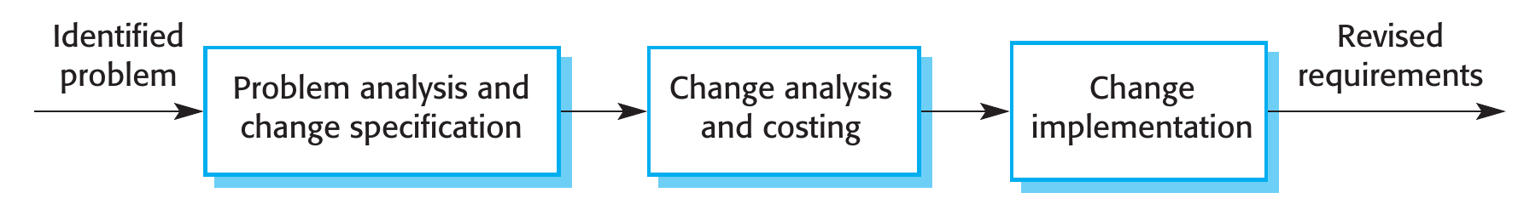
Requirements will change. Plan for it
CHANGE
Why they change
Enduring vs volatile
What you need
The problem can't be fully defined; business and law move; those who pay are not those who use.
Core work activities change slowly. How the organization supports them changes often.
A unique ID per requirement, traceability to design and tests, and one place where changes are decided.
Workshop 3 (W14) runs this loop live: a change request, analysed, costed, and delivered through your own checks.
Source: Sommerville, Software Engineering, 10th ed., §4.6, p. 130–134, Figure 4.19.
18 / 32
Notes:
Figure 4.19: problem analysis and change specification, change analysis and costing (using traceability), change implementation. The enduring/volatile distinction is Sommerville's box on p. 132. On who decides: in agile the user prioritizes the change, but users are not necessarily the best judges of whether a change is cost-effective; an independent authority that balances all stakeholders is often better (p. 132). For the project: the live change request at workshop 3 is this process, and traceability is what makes 'costing' possible in the time available.

Slide 19
What must it support?
PART 2
From requirements to the few architecture characteristics that shape the structure
Software Engineering 2026–27 · Lecture 3
19 / 32
Notes:
Part 2, about 45 minutes. Richards & Ford chapters 4 and 5. Measuring and governing characteristics (chapter 6), styles and the LLM component follow in W6.

Slide 20
Non-functional, seen by an architect
SAME CONCERN, NEW NAME
Sommerville · requirements
Richards & Ford · architecture
Non-functional requirements
Architecture characteristics
Constraints on the services or functions of the system, often applying to the system as a whole.
→
“Nonfunctional” is self-denigrating; “quality attributes” suggests after-the-fact assessment. The authors want a name for what the design must support.
From here on the course uses Richards & Ford's terms: the same concerns, viewed as what the structure has to support.
Sources: Sommerville, Software Engineering, 10th ed., p. 105; Richards & Ford, 2020, ch. 4, p. 55–56.
20 / 32
Notes:
The only bridge between the two vocabularies. Richards & Ford say explicitly why they reject the other two names. Everything that follows in the architecture lectures uses their terms.

Slide 21
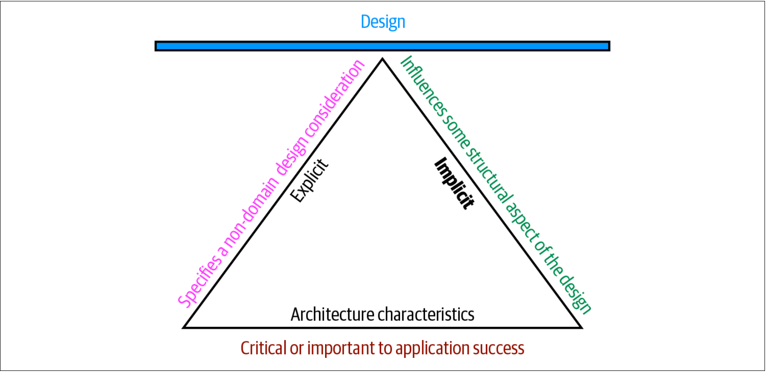
When is it an architecture characteristic?
DEFINITION · ALL THREE MUST HOLD
1 · It isn't a feature
It says how the system must behave or be built, not what it does: performance, security, “no technical debt”.
2 · It shapes the structure
Payments through a third-party processor: good practice is enough. Payments processed in the app: an isolated module. Only the second is architectural.
3 · Success depends on it
Each one adds complexity. Keep only those the system can't succeed without.
Source: Richards & Ford, Fundamentals of Software Architecture, 2020, ch. 4, p. 55–57, Figure 4-2.
21 / 32
Notes:
Richards & Ford's definition in plain words: something is an architecture characteristic only if all three hold. 1. It is a 'nondomain design consideration': not a feature of the domain, but a criterion for how the features must be built or run (their example: no requirements document says 'prevent technical debt', yet it is a design concern). 2. It 'influences some structural aspect of the design': security is in every system, but it becomes architectural only when it needs special structure; handing payments to a third-party processor needs only good hygiene, processing them yourself needs an isolated module. 3. It is 'critical or important to application success': every characteristic you support adds complexity, so the architect's job is to pick the fewest. In the figure the three criteria are the sides of a triangle that holds up the design; 'explicit' and 'implicit' on its sides come back two slides later.

Slide 22
Operational, structural, cross-cutting
A PARTIAL LIST
Operational
Structural
Cross-cutting
How the system runs
How the code is built
Concerns that span both
availability · continuity · performance · recoverability · reliability / safety · robustness · scalability
configurability · extensibility · installability · leverageability / reuse · localization · maintainability · portability · upgradeability
accessibility · archivability · authentication · authorization · legal · privacy · security · supportability · usability
No universal standard: ISO publishes its own list, and every organization its own meanings. Agree on one vocabulary in your team.
Source: Richards & Ford, Fundamentals of Software Architecture, 2020, ch. 4, p. 58–63, Tables 4-1, 4-2 and 4-3.
22 / 32
Notes:
Partial, as the authors say. Read the definitions in the tables at home; some overlap (availability and reliability). Their recommendation from domain-driven design: a ubiquitous language within the team, so that one word means one thing. The 'Italy-ility' box on p. 60 is a nice story about a characteristic invented for one company.

Slide 23
“Never shoot for the best architecture, but rather the least worst architecture.”
TRADE-OFFS
Each characteristic costs design effort and pulls on the others: more security usually means less performance. Like flying a helicopter, one control moves all the others.
Source: Richards & Ford, Fundamentals of Software Architecture, 2020, ch. 4, p. 63–64.
23 / 32
Notes:
Too many characteristics lead to generic architectures that try to solve every problem and rarely work. The authors' conclusion: make the architecture as iterative as possible, so that you don't have to get everything right the first time.

Slide 24
Stakeholders speak in domain concerns
TRANSLATING THE BUSINESS
Domain concern → architecture characteristics · Table 5-1
The trap
Mergers and acquisitions
interoperability, scalability, adaptability, extensibility
“End-of-day fund pricing must finish on time”
Time to market
agility, testability, deployability
Not just performance: also availability, scalability, reliability, recoverability, auditability. Likewise, time to market is agility + testability + deployability.
User satisfaction
performance, availability, fault tolerance, testability, deployability, agility, security
Competitive advantage
agility, testability, deployability, scalability, availability, fault tolerance
Time and budget
simplicity, feasibility
Source: Richards & Ford, Fundamentals of Software Architecture, 2020, ch. 5, p. 65–67, Table 5-1.
24 / 32
Notes:
The 'lost in translation' problem: architects talk about scalability and fault tolerance, stakeholders about mergers and time to market. Table 5-1 is a starting translation. The trap is to translate a concern into its most obvious characteristic only; the fund-pricing example lists the five others an effective architect would add.

Slide 25
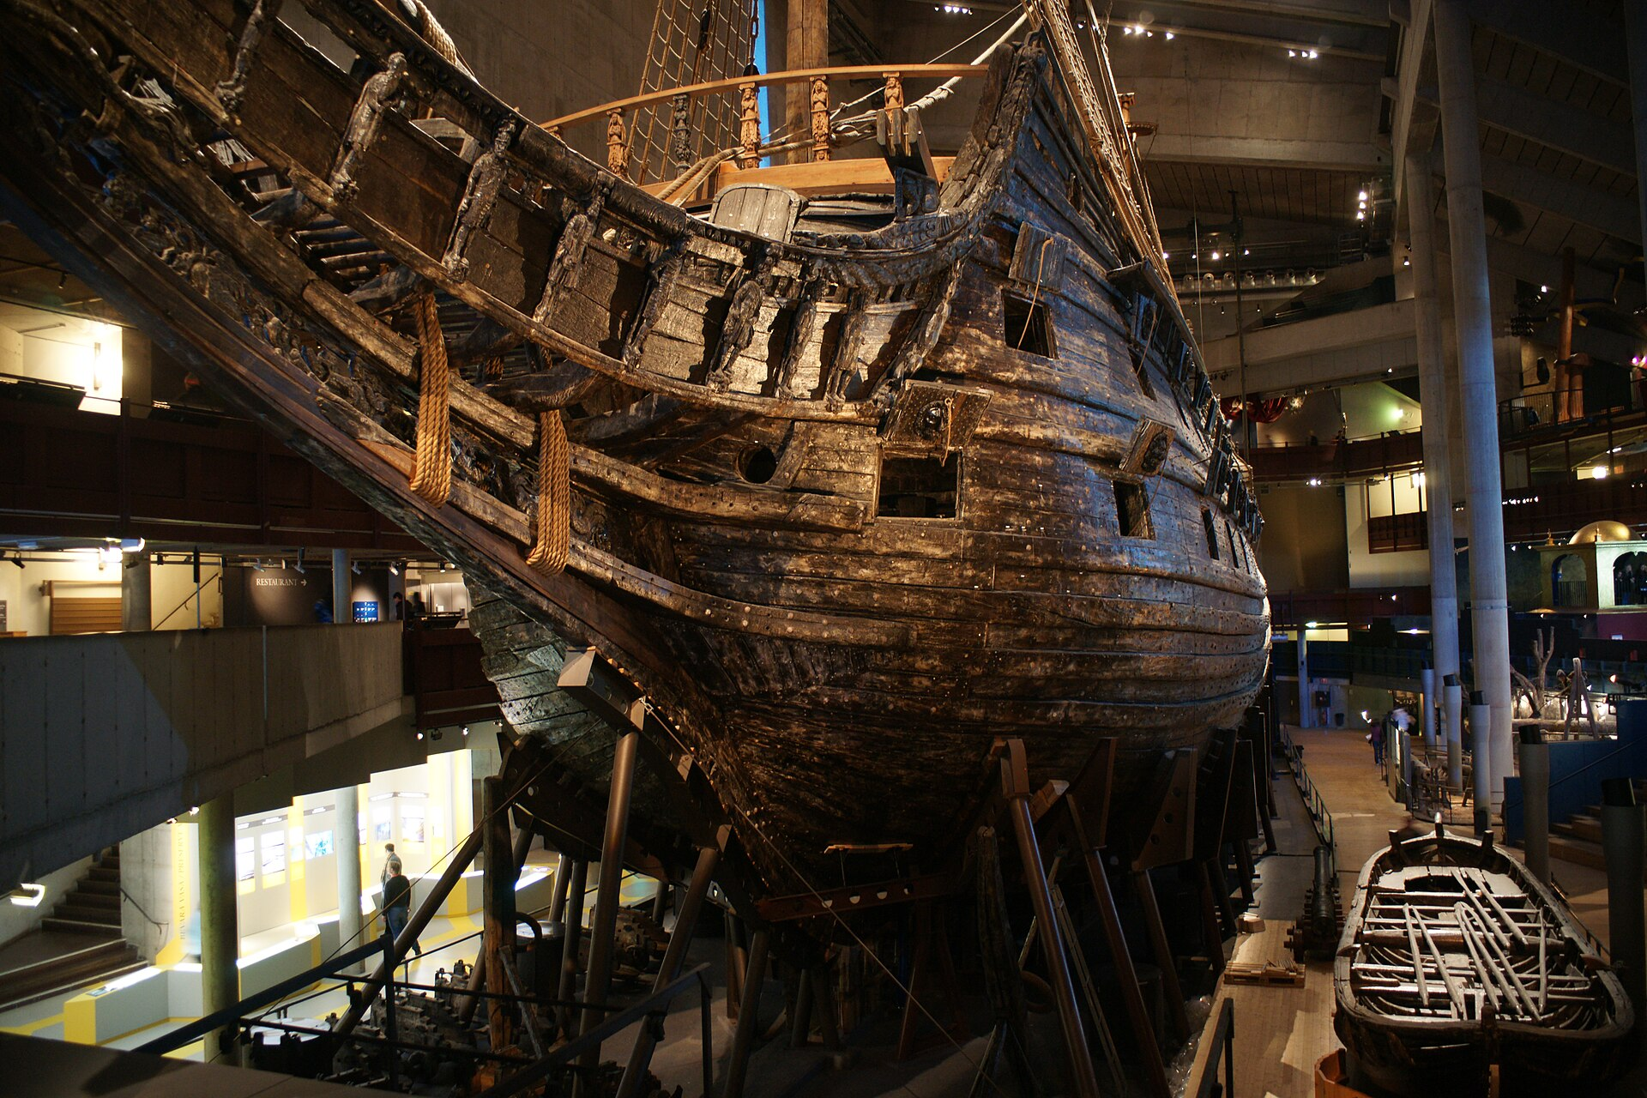
The Vasa: a ship asked to be everything
KEEP THE LIST SHORT
3
Sweden, 1626–1628
Troop ship and gunship in one
Two gun decks, cannons twice the usual size. The builders had doubts but couldn't say no to the king. Top-heavy, it capsized in the harbour.
characteristics, picked by the stakeholders, in any order
Ranking the full list rarely reaches agreement.
Source: Richards & Ford, 2020, ch. 5, p. 65–66. Photo: JavierKohen, Wikimedia Commons, CC BY-SA 3.0.
25 / 32
Notes:
Over-specifying characteristics is as damaging as under-specifying them. The Vasa was meant to be a troop transport and a gunship at once, with two gun decks and oversized cannons; the shipbuilders had doubts but could not say no to King Gustavus Adolphus. It sailed into the harbour, fired a salute from one side and capsized. Salvaged in the 20th century, it is now in the Vasa Museum in Stockholm (the photo). Instead of ranking every characteristic, which wastes time and causes disagreement, ask stakeholders to choose the top three in any order: easier consensus, and it starts the right discussion.

Slide 26
1,000 students, 10 hours, the last 10 minutes
EXPLICIT AND IMPLICIT
1,000
Explicit
Stated in the requirements: expected number of users, scale, a response time someone asked for.
students register for courses within 10 hours. Spread evenly, or all in the last 10 minutes? Anyone who knows students knows the answer. It won't be in the requirements.
Implicit
Rarely written, still necessary: availability, reliability, security, and load shapes like this one. Found through domain knowledge.
You know this domain from the inside: exam-session sign-ups, a Moodle deadline at 23:59.
Source: Richards & Ford, Fundamentals of Software Architecture, 2020, ch. 4, p. 57; ch. 5, p. 67–68. Callout: course content.
26 / 32
Notes:
The authors' own example, a university class registration system. The point: domain knowledge produces characteristics that nobody writes down. Ask the room what the load on a quiz or a registration system looks like a minute before the deadline. In their own projects, the equivalent question is: what do you know about your users that your requirements don't say?

Slide 27
Silicon Sandwiches, worked through
WORKED EXAMPLE · ARCHITECTURE KATA
Description
A sandwich chain adds online ordering.
Scalability “perhaps one day millions”
Users
Thousands, perhaps one day millions.
Elasticity lunchtime bursts: in the domain, not the brief
Requirements
Pickup time and directions (external traffic maps); delivery; mobile access; national and local specials; pay online, in shop or on delivery.
Performance nobody waits at peak time
Availability, reliability implicit
Context
Franchises, different owners; overseas soon; cheap labour.
Customizability national + local specials, local directions
Design only payment security via a third party, i18n, usability
Customizability: a microkernel style, or the Template Method pattern? Architecture or design is itself a trade-off. “There are no wrong answers in architecture, only expensive ones.”
Source: Richards & Ford, Fundamentals of Software Architecture, 2020, ch. 5, p. 68–75.
27 / 32
Notes:
The kata format (description, users, requirements, additional context) is Ted Neward's, adapted by the authors. Walk through it as they do: users imply scalability; mealtimes imply elasticity; external mapping services are an integration point (should the site fail if traffic data is down, or degrade?); specials imply customizability. Security: if payments go to a third party, standard hygiene is enough, so no special structure. Franchising brings cost constraints: check feasibility, maybe a simple architecture is warranted. Expansion overseas and cheap labour drive design (i18n, usability), not structure.

Slide 28
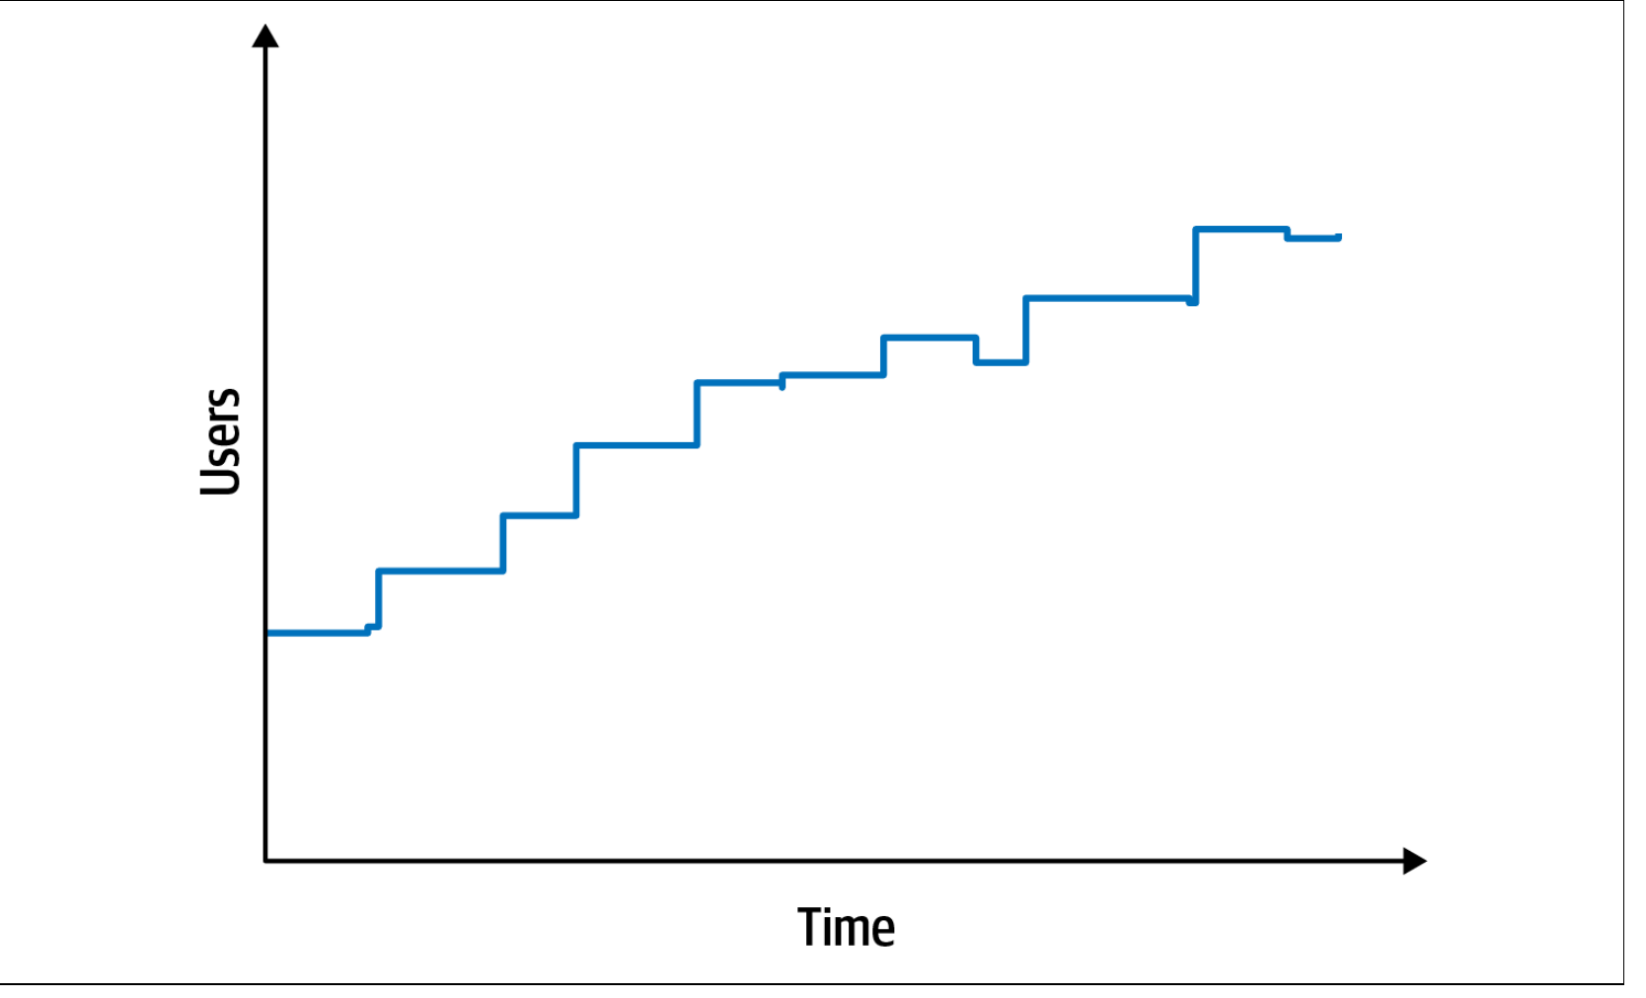
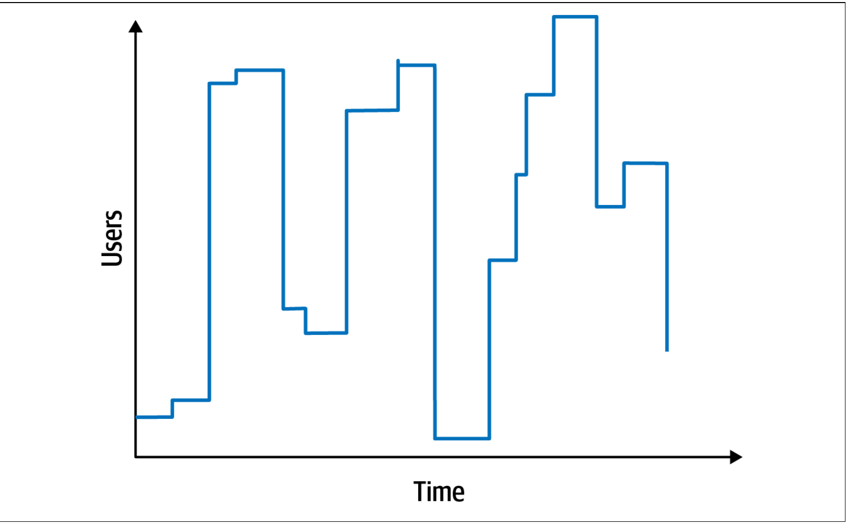
Many users, or many users at once?
SCALABILITY IS NOT ELASTICITY
Scalability Performance holds as concurrent users grow. A hotel reservation system.
Elasticity Withstands bursts. A concert ticket sale, or a sandwich shop at lunch.
Often lumped together, with different constraints. Elastic systems usually need to scale too, not the other way round.
Source: Richards & Ford, Fundamentals of Software Architecture, 2020, ch. 5, p. 70–71, Figures 5-1 and 5-2.
28 / 32
Notes:
The two characteristics from the kata that students most often confuse. A hotel booking system has steady load; a ticket sale has spikes. The question for their projects: does your load grow, spike, or neither? An honest 'neither' is a legitimate answer and keeps the architecture simple.

Slide 29
Ticketmaster: let them in at a rate
CASE · WHEN ELASTICITY IS NOT ENOUGH
3.5 bn
Planned vs happened
The pattern: a waiting room
1.5 million fans invited with codes, 2 million more on a waiting list. Bots and fans without codes flooded the site anyway: hours of queueing, lost places, and the general sale was cancelled. Bot traffic: 3× anything seen before.
Everyone waits in a virtual queue; only a few hundred shop at once, admitted as places free up. Early arrivals can be shuffled at the start. Checkout sees a steady flow, not the burst.
system requests in one presale, 4× the previous peak: Taylor Swift's Eras Tour, 15 Nov 2022.
Instead of scaling everything to the peak, shape the peak: users wait longer, the system stays up. A trade-off, chosen on purpose.
Sources: Ticketmaster via NBC Chicago, 17 Nov 2022; Semafor, 24 Jan 2023; Ticketmaster Smart Queue guide; Queue-it docs.
29 / 32
Notes:
A real elasticity story. 15 November 2022, Eras Tour presale on Ticketmaster: 3.5 billion system requests, four times their previous peak (Ticketmaster's own statement, 17 Nov 2022). The Verified Fan programme had invited 1.5 million fans with codes and put about 2 million more on a waiting list; bots and fans without codes drove the traffic anyway. Ticketmaster slowed and postponed sales to stabilise the system; fans waited for hours, some lost their place; more than 2 million tickets were still sold that day; the general public sale on 18 November was cancelled. At the US Senate hearing (24 Jan 2023), Live Nation's Joe Berchtold said bot traffic was three times anything they had seen before. The architectural answer is the virtual waiting room (Ticketmaster calls theirs Smart Queue): fans join a waiting room before the sale, get a place in line, and are admitted at a controlled rate; Ticketmaster's guide says only a few hundred people can shop at once, and your place is held for 10 minutes when your turn comes. Commercial waiting rooms such as Queue-it let the site set the outflow rate to what it can handle and randomise those who arrived before the start. Link to the lecture: elasticity is expensive and has limits; a queue is a deliberate trade-off between latency and availability, an architecture decision, not a bug. Ask the room: which of their own systems would need a queue, and which would only need to say 'try again later'?

Slide 30
Reading for this lecture
TO READ
Book | Section | Pages
Sommerville | 4.1 Functional and non-functional requirements | 105–111
 | 4.4 Requirements specification (4.4.1, 4.4.2, 4.4.4) | 120–124, 126
 | 4.5 Requirements validation · 4.6 Requirements change | 129–134
 | 8.3.1 Requirements-based testing | 245–246
Richards & Ford | Ch. 4 Architecture Characteristics Defined | 55–64
 | Ch. 5 Identifying Architectural Characteristics | 65–76
 | Ch. 23 Negotiating with Business Stakeholders | 348–350
These pages are what the quiz questions and the project rubric for specification and architecture characteristics are built on.
Software Engineering 2026–27 · Lecture 3
30 / 32
Notes:
Sommerville sections 4.1, 4.4 (without the use cases subsection), 4.5 and 4.6; the requirements-based testing subsection from chapter 8 for the acceptance criteria slide. Richards & Ford chapters 4 and 5 in full, and the first negotiation section of chapter 23.

Slide 31
Before workshop 1: the direction sheet
OPTIONAL · NOT GRADED
Section 7 · after today
If you get this far
5 to 10 candidate requirements
Your top three architecture characteristics
Priority: must, should, could, won't. Type: functional, product, organizational, external. Source and rationale. How you will check it: a test, or a measure with a threshold.
Each with the requirement or domain concern it comes from. Implicit ones count.
Workshop 1 · W5 · 26–30 Oct: we will post a calendar, and each team books its own slot in the 4-hour window, with Rareș and Petru. Bring DIRECTIE.md in your repository.
Software Engineering 2026–27 · Lecture 3
31 / 32
Notes:
Logistics for workshop 1: a booking calendar will be posted on Teams; each team picks a slot within the 4-hour window and works on its direction with Rareș and Petru. Section 7 of the direction sheet was planned for after this lecture. The second card applies Part 2 to their own system; it gives workshop 1 a concrete starting point for the architecture discussion in W6.

Slide 32
Questions?
LECTURE 3 · W4
Architecture continues in W6: styles, the LLM component, measuring characteristics.
Software Engineering 2026–27 · Lecture 3
32 / 32
Notes:
End of lecture.

